Slide 1
The Shot Heard Round the World:
A Nation is Born
A Revolutionary War Lesson Plan

Slide 2
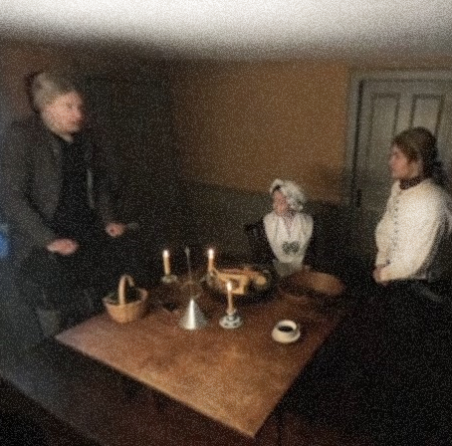
Choices
Discuss:
In your opinion, which character in the video had the most difficult choice?
What other choices did people face at the beginning of the American Revolution?
If you lived in 1775, what choices do you think you might have made?

Slide 3
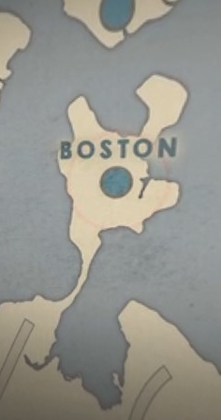
In Boston, Massachusetts
Massachusetts Bay Colony was founded in 1630.
By the mid-1700’s, Massachusetts was one of the most prosperous colonies and had a busy seaport and capital at Boston.
Massachusetts became a center of resistance to British taxes. Boston was the scene of confrontations like the Boston Massacre (1770) and Boston Tea Party (1773).
The Sons of Liberty organized protests and British soldiers sent to Boston.
In 1774 the Massachusetts Provincial Congress tried to seize control of the colony from the British Royal Governor. This Congress also asked local militia units to prepare to defend the colony’s weapons and supplies from the British soldiers.
Notes:
Learn more:
Boston Massacre: https://www.battlefields.org/learn/articles/boston-massacre
Boston Tea Party: https://www.battlefields.org/learn/topics/boston-tea-party
The British Army in Boston: https://www.battlefields.org/learn/articles/british-army-boston
Who were the Sons of Liberty?: https://www.battlefields.org/learn/articles/who-were-sons-liberty

Slide 4
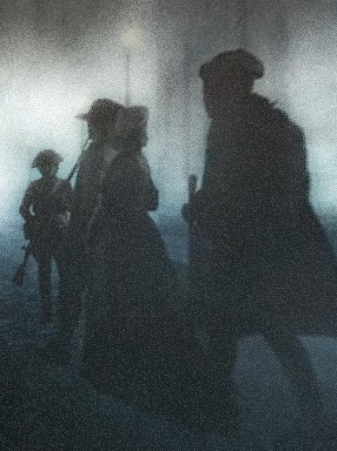
1775: After Years of Rising Conflict
The British government amassed an enormous debt due to the cost of raising, supplying, and funding an army on foreign soil during the French & Indian War (1754-1763).
Expecting the Americans to shoulder some of the financial burden, Parliament levied several acts of taxation: The Sugar Act (1764), the Stamp Act (1765), and the Townshend Acts(1767).
Years of unrest and discord followed. The Americans maintained that Parliament could make laws, but insisted only their elected representatives could tax them. The English felt that Parliament had supreme authority over the colonies.
The Americans formed Committees of Correspondence and a Continental Congress to find solutions but could not find common ground with the English.
Notes:
Learn more:
American Revolution FAQs: https://www.battlefields.org/learn/articles/american-revolution-faqs

Slide 5
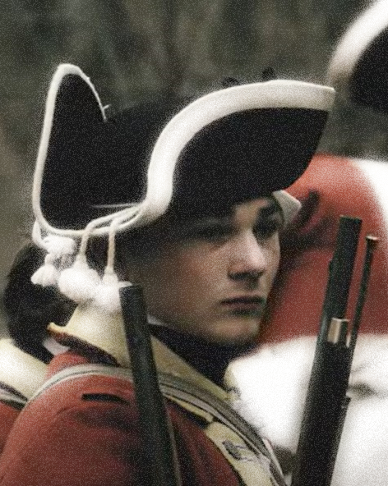
The British
The British Army of the late 18th century was a volunteer force, not impressed (forced) into service.
Most of men who volunteered for service were farm laborers or tradesmen who were out of work.
Life in the army promised steady pay, regular meals, and a way to escape grinding poverty.
Recruits were generally young, averaging in their early 20s, and were drawn from all over Britain and Ireland.
By the eve of the American Revolution, most of the men in the ranks had never seen active military service and were not battle-hardened veterans. The exception were many of the army’s non-commissioned officers. These men formed the backbone of the regiment and were often veterans of many years or even decades of service.
Notes:
Extra Resources:
Throughout 1774 and into 1775, thousands of British troops, led by General Thomas Gage would take over the city, putting them on a collision course with revolutionary fervor both in town and the countryside. Gage’s lack of harsh measures against the Bostonians, in the opinion of many officers of the army, only made things worse. Captain Francis Lord Rawdon, writing to his uncle at home in 1775, informed him “I believe General Gage to be a very worthy man, & really do not doubt but his want of activity proceeded from a fear of hurrying these Americans into rebellion by harsh measures. The people about him I believe blinded him to the true state of affairs, & buoyed him up with hopes that the hostile declarations of the Bostonians were only the clamour of a small wrongheaded party, whose rage would quickly subside if left to itself, whereas any exertion of military force might only make the affairs become serious.” The events of April 19, 1775, were a culmination of many altercations between local militia and British Regular soldiers.
The British Army in Boston: https://www.battlefields.org/learn/articles/british-army-boston
Thomas Gage: https://www.battlefields.org/learn/biographies/thomas-gage
Francis Smith: https://www.battlefields.org/learn/biographies/francis-smith
John Pitcairn: https://www.battlefields.org/learn/biographies/john-pitcairn
Hugh Percy: https://www.battlefields.org/learn/biographies/hugh-percy
The British Army during the American Revolution: https://www.battlefields.org/learn/articles/british-army-american-revolution

Slide 6
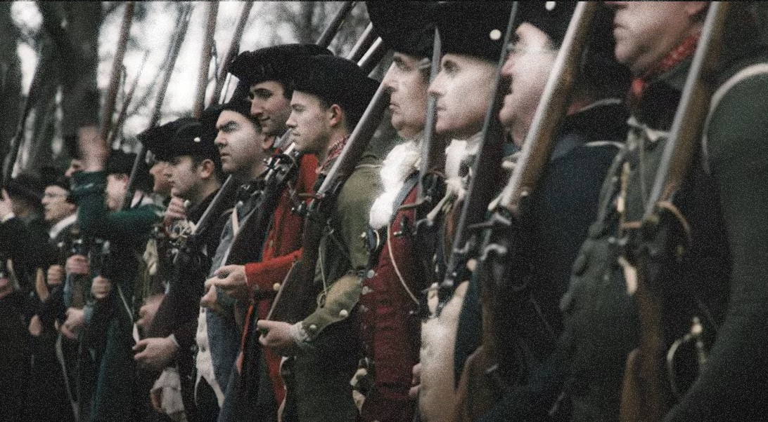
Militia & Minutemen
Militia units served as the backbone of protection in the colonies. They created a community bond that connected many far-flung neighbors. Most militias would muster and train in town and county centers, usually on court days. The events tended to have the air of a county festival, where entire communities came out to witness the drill and then host festivities afterward. Militias were the main colonial military organization for defense, but they were only part-time.
Minuteman companies were officially created by the Massachusetts Provincial Congress in October 1774 to be the best soldiers of each militia company. They regularly trained, and some were paid. They were to respond, “at a minute’s notice.”
Both Minutemen and Militia companies responded on April 19, 1775.
Notes:
Extra Resources:
Militia, Minutemen, and Continentals: The American Military Force in the American Revolution: https://www.battlefields.org/learn/articles/militia-minutemen-and-continentals-american-military-force-american-revolution
As events around Boston became more tense, many communities in Massachusetts began to create more elite companies of minutemen. Militias mostly trained on a seasonal basis, but minutemen companies were established to provide more regular training (sometimes weekly) of the best men in the militia. They were expected to respond quickly to danger at a “minute’s notice.” Some of the first minutemen companies were created in Worcester, Massachusetts, in September 1774. Soon, the Massachusetts Provincial Congress adopted this organizational structure for all Massachusetts militia units in October that same year. Other New England colonies began to do the same. Some of these units were in action on April 19, 1775, but contrary to popular thought, most of the colonial units that responded that day were not minutemen companies, but regular militia.

Slide 7
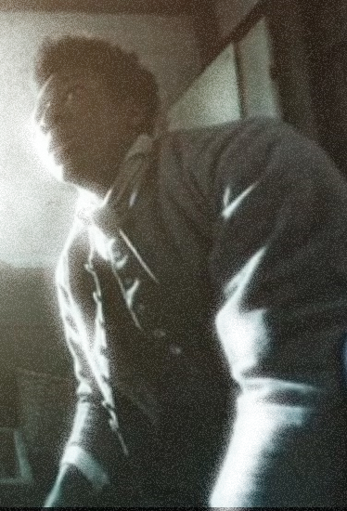
Enslaved & Free Black Men
On April 19, 1775, Massachusetts militiamen of color—free and enslaved—along with their white comrades opposed British troops.
Black men served in Minute companies, as well as the normal embodied militia.
So far, researchers have identified the names of 35 Black men present that day and at least 18 saw combat.
Prince Estabrook, was wounded while with Captain John Parker’s company on Lexington Green.
Notes:
Extra Resources:
At the onset of the War for Independence, approximately 500,000 African Americans lived in the colonies, of whom some 450,000 (90 percent) were enslaved. Black men fought in provincial regiments prior to the war, and roughly 5,000 African American soldiers and sailors, free and slave, served the Revolutionary cause. Black Soldiers in the Continental Army and states’ militia fought in every major battle of the war, and in most, if not all of the lesser actions. The same was not true of the Crown forces during the conflict. On April 19, 1775, Massachusetts militiamen of color, free and enslaved, along with their white comrades opposed British troops during the operations intended to seize American arms that ended in a harried retreat to the safety of Boston. Blacks served in Minute companies, as well as the normal embodied militia. To date, we have the names of 35 black men present that day, at least 18 seeing combat. One, Prince Estabrook, was wounded while with Captain John Parker’s company on Lexington Green. Historian John Hannigan notes that, given incomplete records, it is likely that as many as 40 to 50 African Americans were with the militia on the war’s first day.
Learn more:
10 Facts: Black Patriots during the American Revolution: https://www.battlefields.org/learn/articles/10-facts-black-patriots-american-revolution
Prince Estabrook: https://www.battlefields.org/learn/biographies/prince-estabrook

Slide 8
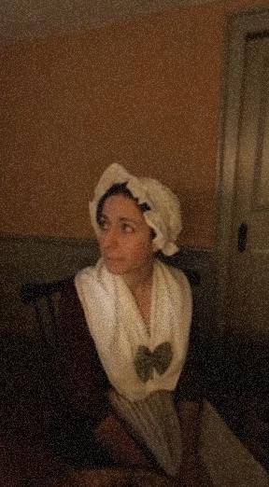
Women
Women responded individually and in different ways to the events of that historic day, April 19, 1775.
Some hid in their homes while others refugeed away from the road and the fighting.
Some spoke with British soldiers while others armed for a fight.
Most mothers had the safety of their young children as a top priority that day.
Some women took care of the wounded or returned home to find dead and injured soldiers in their houses.
Whether they fled, resisted or assisted—or a combination of those actions—women were present as battle came passed or through their homes at the start of the American Revolution.
Notes:
Extra Resources:
On April 19, 1775, shots fired near the villages of Lexington and Concord brought war to the Massachusetts countryside and started the American Revolution. While Minute Men and militia companies rushed to respond to the advancing British column, women faced dangers and challenges on the new home front. The village greens, house yards and roads of their communities became the battlefield, and many numbered their loved ones among the militia and Minute Men. Many of the stories that exist about women’s actions on that historic day are not always clear in the history books and many legends exist; still, this points to women’s presence, even as the details are obscure or sometimes difficult to fully untangle.
Read more: https://www.battlefields.org/learn/articles/women-and-battle-lexington-and-concord

Slide 9
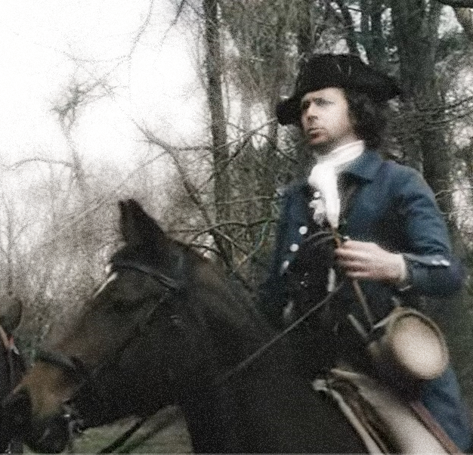
April 18: Messengers
Paul Revere, William Dawes and Samuel Prescott carried the news of the British advance to Concord.
Other messengers took the news to other villages, rallying more militia units.
The midnight messengers completed their mission. The militia had been summoned to meet the British Regulars.
Notes:
Extra Resources:
Paul Revere, William Dawes, and Samuel Prescott had alerted the towns of Lexington and Concord early that morning with the reports that the “regulars,” term for British Redcoats, were on the march from Boston. The warning reached John Hancock and Samuel Adams in Lexington who escaped, as the belief of Dr. Joseph Warren, part of the Committee of Correspondence and still residing in Boston, and according to him the British Army may have marched out of Boston to seek their arrest.
The British contingent, under orders from General Thomas Gage, commander of His Majesty’s forces in Colonial America, consisted of light and grenadier companies, with Royal Marines, under the command of Lieutenant Colonel Francis Smith of the 10th Regiment of Foot and Major John Pitcairn of the marines as second-in-command. Their mission, which Gage hoped to be cloaked in secrecy, was to confiscate and destroy the military supplies secreted in Concord.

Slide 10
April 19: Lexington Green
About 80 militiamen commanded by Captain John Parker waited on Lexington’s village green to present a show of force to the arriving British column.
Parker ordered his men to disperse when challenged by a British officer.
No one knows who fired the first shot, but it was followed by a British volley and then Americans returned fire.
When the confrontation was over, 8 militiamen had been killed and 10 wounded, and 1 British soldier had been wounded.
The British continued their march toward Concord.
Notes:
Extra Resources:
https://www.battlefields.org/learn/biographies/john-parker
In April 1775, word arrived in Lexington that the British were marching from Boston to seize and or destroy Patriot military supplies at Concord. At this point, John Parker was forty-six years old, suffering from tuberculosis and on his death bed. On the morning of the April 19, he mustered his strength and walked two miles to Lexington Green to take command of the seventy or so militiamen awaiting the British regulars. Here, Parker is said to have told his men, “Stand your ground. Don’t fire unless fired upon, but if they mean to have a war, let it begin here.”
Nobody knew who fired the first shot of the American Revolution, but in the brief skirmish on Lexington Green, eight of Parker's men died (including his cousin Josiah) and another ten men fell wounded. The British column continued their march to Concord,

Slide 11
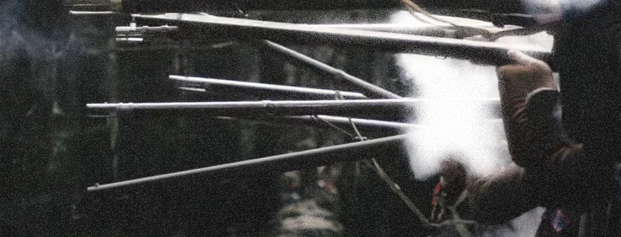
April 19: Concord
Worried that the British were burning the village of Concord, Colonel Barrett ordered the assembled Massachusetts militia to advance toward Old North Bridge.
Shots were fired, and the fight at the bridge became known as the “Shot Heard ‘Round the World.”
Militia officers and men fell dead and wounded. The British soldiers retreated, rejoining the rest of their force in town.
Notes:
Extra Resources:
James Barrett: https://www.battlefields.org/learn/biographies/james-barrett
Through a network of informants and midnight messengers word reached Concord in the early morning of April 19 that a British force had left Boston and was known to be heading for Concord to seize the cannons and other military supplies. The cannons had already been moved to Groton, a village nearly twenty miles away, and the other military supplies had also been hidden.
On April 19, 1775, approximately 700 British troops arrived in Concord. They had already met resistance from local militia at Lexington during their march and shots had been fired. While a detachment of British soldiers searched Barrett’s farm and talked with Mrs. Barrett, the militia assembled near the Old North Bridge, leaving the village in British hands for the moment.

Slide 12
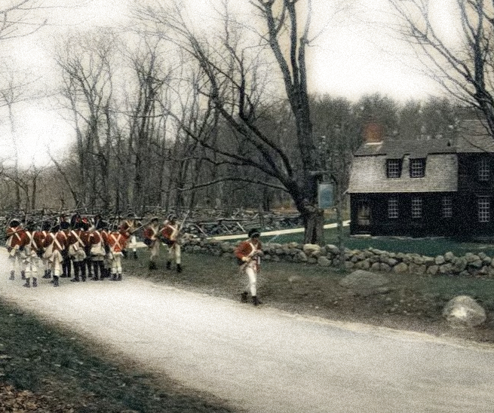
April 19: Battle Road
British troops began retreating from Concord back toward Boston, nearly 20 miles away.
Massachusetts militiamen followed the retreating British, hiding and attacking from ambushes.
The road the British soldiers marched along became known as Battle Road.
Notes:
Lt. Col. Smith ordered the entire British command back toward Boston, twenty-soon-to-be-hellish miles away.
Thus, the “shot heard around the world” faded into the history books, as more shots, many more, would be fired in the ensuing hours as the British were harried back to the safety of the environs of Boston. Standing within view of the North Bridge was The Old Manse, constructed in 1770 for Reverend William Emerson, who witnessed the actions of April 19, 1775. His grandson, in 1837, the writer and poet, Ralph Waldo Emerson ended the first stanza of the “Concord Hymn” with the line:
“And fired the shot heard round the world.”
Although not uttered at the time of the engagement in April 1775, the “shot” marked the turning point of the fracas between the American Colonies and Great Britain. With shots fired, there was no turning back, and that evening the British found themselves trapped in Boston. Within months, George Washington, a Virginian, would be elected commander of the Continental Army. Six years and six months later, the British surrendered at Yorktown, Virginia, which marked the unofficial end of the American Revolution. Two years after that, the Treaty of Paris was signed between the two initial warring parties and American ally France.
The actions at Concord, at Lexington earlier that same day, and along the stretch of Massachusetts countryside now remembered simply as “Battle Road” were the “shots heard round the world” transitioned the war of words to one of bullets and the long trek to American independence.

Slide 13
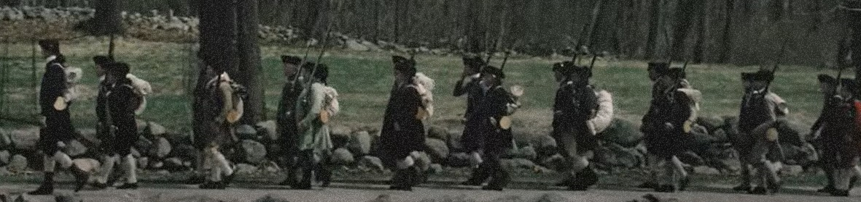
April 19: Battle Road, Reinforcements
Alerted by a network of messengers, militias in villages and neighborhoods further from Lexington and Concord rallied and began to march.
Arriving near Battle Road, these militias joined the fight, taking cover behind trees and stone walls and firing at the British.
Notes:
Nearly 130 colonial militiamen and Regulars were killed on April 19, 1775. The fighting along the “Battle Road” grew bloody as the Regulars marched from Concord towards Lexington and back to Boston. But the bloodiest and fiercest fighting took place in Menotomy (modern-day Arlington) along modern-day Massachusetts Avenue. Here the fighting became hand to hand and brutal. Harassed for miles, British soldiers began to go house to house clearing families from the buildings along the road. In the fighting in this stretch, nearly 25 colonists and 40 British regulars were killed, half the day’s death count.

Slide 14
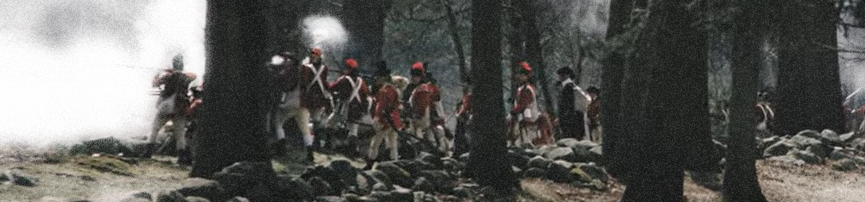
April 19: Battle Road, Parker’s Revenge
Captain Parker waited with his Lexington militia and a fierce fight called “Parker’s Revenge.”
As the British soldiers retreated from Parker’s Attack, they arrived in Lexington and met British reinforcements who had marched from Boston.
Notes:
Learn more:
Parker’s Revenge: https://www.battlefields.org/learn/articles/significance-parkers-revenge
The battle ground at “Parker’s Revenge” is one of the most important sites along the Battle Road, the route of the British retreat from Concord toward Boston on the afternoon of April 19, 1775. The British had failed to find a large quantity of arms at Concord. News of the British expedition and of the deaths of militiamen on the Lexington Green had spread across eastern Massachusetts. By noon, when the British began their march from Concord, the countryside was filled with angry militia companies.
As the British made their way from Concord back toward Lexington — about eight miles by a narrow road that wound past farms and pastures dotted with rocks and crossed by ditches and stone walls — American militia companies used country paths to intercept and ambush the enemy. A British ensign later wrote: “all the hills on each side of us were covered with rebels.” Americans fired on the British column at Merriam’s Corner, then at Brooks Hill, and a nameless turn in the road that became known as the Bloody Curve.
As the British column reached the line between the towns of Lincoln and Lexington, Capt. John Parker and his Lexington militia were waiting for them. Parker’s company included men who had fought that morning on Lexington Green. Some wore bandages stiffened from the blood of wounds they had suffered in the morning, and they were anxious to revenge themselves and their dead neighbors. Parker’s men confronted the British on a rocky hillside. Waiting until the British were close, they opened fire. The British were staggered, then charged the hill. Parker's men shot down several Regulars before retreating, and lost men of their own. Jedediah Munroe, who had been wounded on the Lexington Green at dawn, was killed.
At Parker's Revenge, the militia demonstrated the kind of courage and determination that sustained American soldiers through the eight years of the Revolutionary War. Parker’s men had been defeated that morning on the Lexington Green, but after the shock of that first battle, they had reorganized, and had waited bravely for the retreating British to renew the battle.

Slide 15
April 19: Back to Boston
The heaviest fighting of the day occurred between Lexington and Boston as the British retreat continued and more militia companies joined the attacks.
When the British reached the cover of their ships’ guns near Charles Town and from Boston Harbor, the militia’s pursuit paused.
By the end of the day, approximately 93 Americans had been killed, wounded or were missing. There were 300 British casualties.
Notes:
Hugh Percy marched more than one thousand soldiers to Lexington, meeting Smith’s troops who had been ambushed as they retreat from Concord. Percy’s hurried arrival with reinforcements and cannon protected Smith’s battered force, but the British retreat continued under attack and ambush from militiamen lining the road to the outskirts of Charlestown and Boston. After fighting back to safety, Percy gave the militia rebels respect, acknowledging they were organized in their resistance and fought well, using terrain to their advantage.
The British conduct a running fight until they can reach the cover of British guns on ships anchored in the waterways surrounding Boston. The Patriots chase them but, having no clear orders, ultimately let them escape.
In the wake of Lexington and Concord, Governor Gage finds Boston faced by a huge militia of men who have arrived from throughout New England to fight for liberty. Numbering 20,000, this resolute force will become part of the Continental Army.

Slide 16
Beginning of the American Revolution
Each side hurried to write about and portray the events of April 19 in ways that favored them and their cause.
The fighting on April 19, 1775, at Lexington and Concord marks the beginning of the American Revolution.
Though it was more than a year until the Declaration of Independence would be signed, the journey of revolution and new nation started along Battle Road.
Notes:
Learn more:
After the fighting ended at Lexington and Concord, the Massachusetts Provincial Congress began to take dispositions from those involved in the fighting on April 19, 1775. Colonial leaders were experts in public relations and knew that they needed to control the narrative of the events in Lexington and Concord if they were to succeed in a revolution. They believed that General Gage and the British military were the aggressors and agitators and knew it would be important to portray them as such as they attempted to gain other colonial support within North America. Dozens of these interviews were conducted in the days, weeks, and months after the fighting. Hundreds of pages of transcripts from these interviews are still available today. Likewise, albeit a little later, British authorities took dispositions from their soldiers as well. As the war progressed, both sides spent a lot less time getting testimonies from those involved in battles. These accounts after Lexington and Concord from both sides gives historians a great insight into the events of April 19, 1775, in an otherwise under documented period of history.

Slide 17

“Shot Heard ‘Round
The World”
Reverend William Emerson witnessed the actions of April 19, 1775. His grandson, in 1837, the writer and poet, Ralph Waldo Emerson ended the first stanza of the “Concord Hymn” with the line: “And fired the shot heard round the world.”
The “shot” marked the turning point of the fracas between the American Colonies and Great Britain.
The “shots heard round the world” transitioned the war of words to one of bullets and the long trek to American independence.
Notes:
Although not uttered at the time of the engagement in April 1775, the “shot” marked the turning point of the fracas between the American Colonies and Great Britain. With shots fired, there was no turning back, and that evening the British found themselves trapped in Boston. Within months, George Washington, a Virginian, would be elected commander of the Continental Army. Six years and six months later, the British surrendered at Yorktown, Virginia, which marked the unofficial end of the American Revolution. Two years after that, the Treaty of Paris was signed between the two initial warring parties and American ally France.
The actions at Concord, at Lexington earlier that same day, and along the stretch of Massachusetts countryside now remembered simply as “Battle Road” were the “shots heard round the world” transitioned the war of words to one of bullets and the long trek to American independence.
Read more:
“Shot Heard ‘Round The World”: https://www.battlefields.org/learn/articles/shot-heard-round-world

Slide 18
Notes:
Always more FREE resources at www.battlefields.org

